Slide 1
ProMuteHT 2.0: High-throughput In Silico Generation of Protein Mutants
Katie Hursh, Dr. Filip Jagodzinski

Slide 2
Introduction
Key Terms
Project Goals
Motivation
Related Work
Previous Version
Contributions
Results

Slide 3
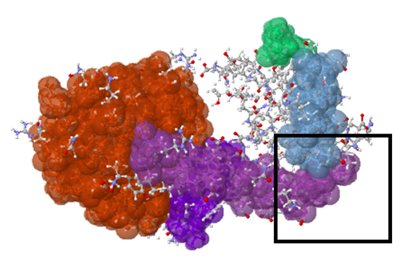
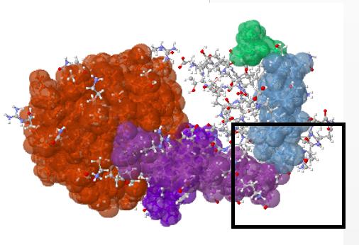
Key Terms
Mutagenesis: process changing genetic information
Wet Lab: laboratories for handling chemicals, drugs or biological matter
Amino Acid: building block for genetic material
Notes:
Mutagenesis: process by which the genetic information of an organism is changed, resulting in a mutation
Wet Lab: laboratories with specialty equipment for handling chemicals, drugs or biological matter
Amino Acid: Organic compound acting as a building block for genetic material

Slide 4
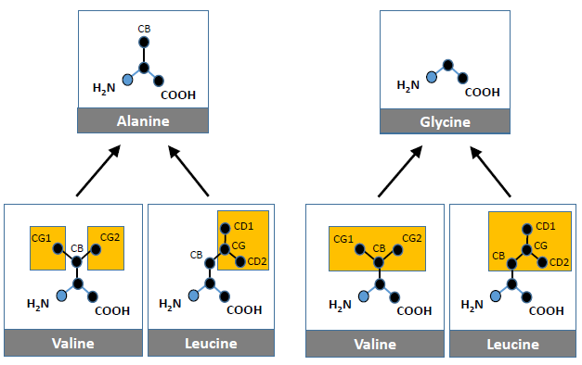
Key Terms
Residue: A specific amino acid within a protein
Large-to-Small: Mutation where the number of atoms is reduced
Small-to-Large: Mutation where the number of atoms is increased
Energy Minimization: Process of arranging atoms so that inter-atom forces are sufficiently close to zero

Slide 5
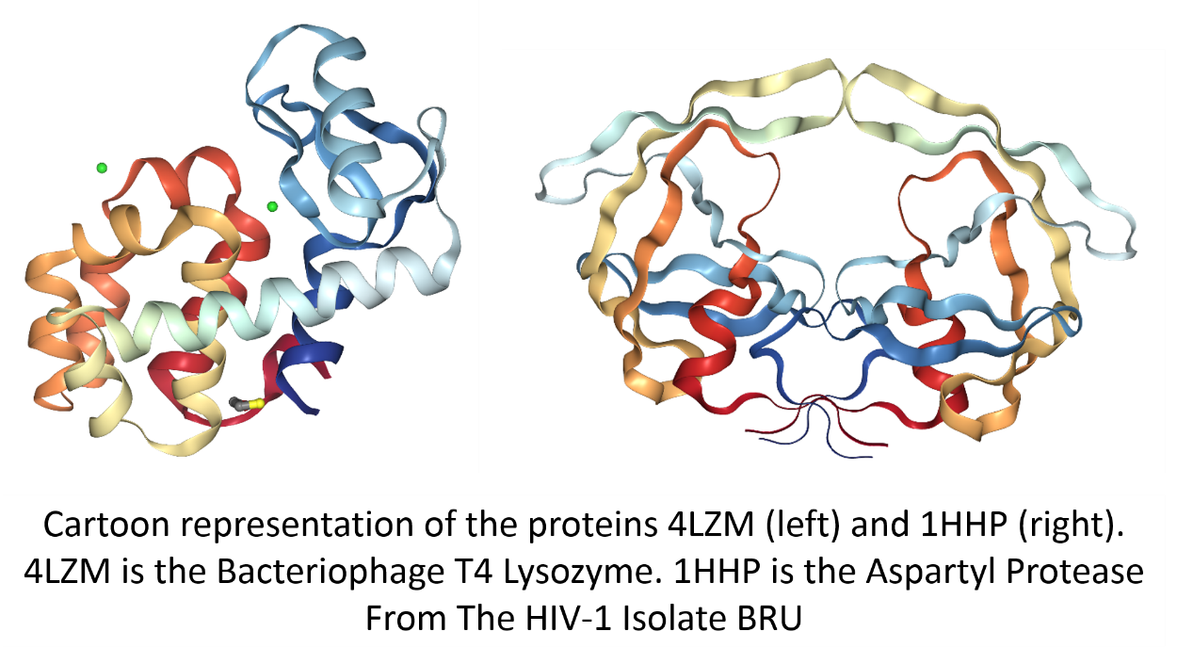
Project Goals
Program to estimate the result of mutating residues of a protein
Efficient and scriptable pipeline
Take into account biophysical properties of the wild type protein to speed up mutation generation process

Slide 6
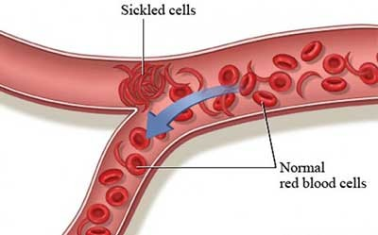
Motivation
Wet lab experiments are prohibitively expensive
Limited number of mutagenesis experiments
Result is useful for disease and medicine research
Huge number of possible mutations
Reduce the list of candidates

Slide 7
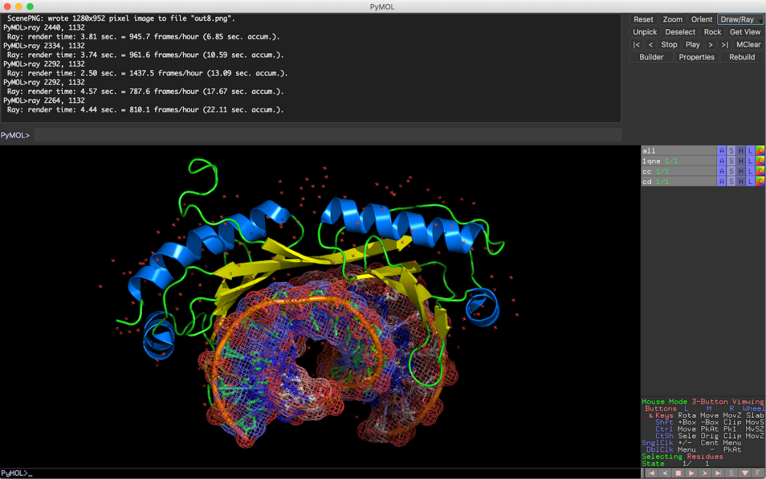
Related Work
Related programs are complex and time consuming
Require expensive energy calculations
Require human interaction
Unusable for scripted mutations
Examples
PyMol
Swiss PDB Viewer
FoldX
Scwrl

Slide 8
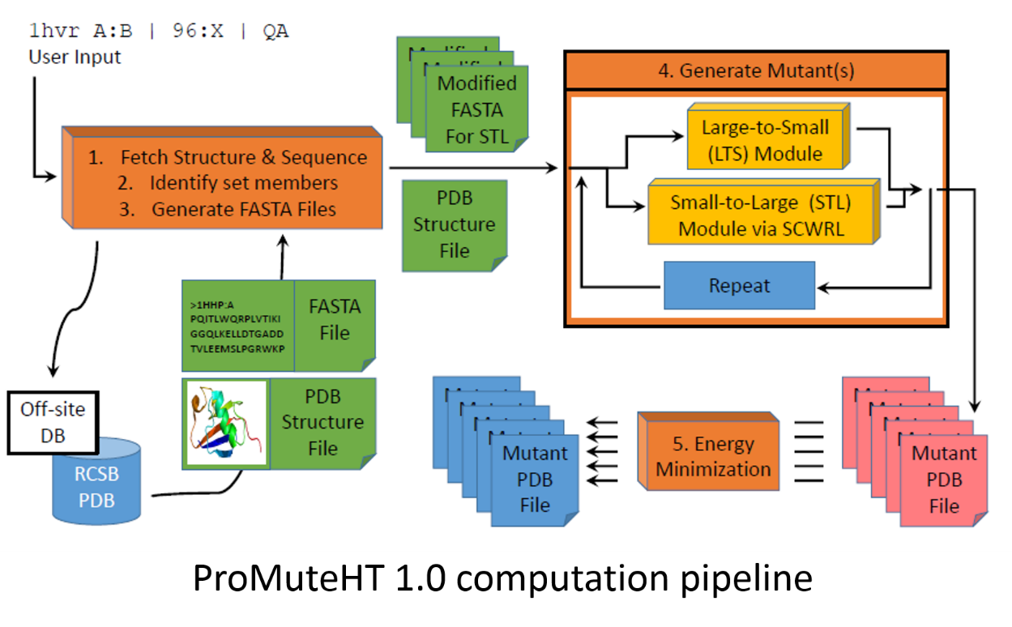
Previous Version
Scriptable pipeline for predicting mutation results
Incorporated Scwrl for small-to-large mutations
Mixture of python, shell scripts, and C++
Large number of folders and files

Slide 9
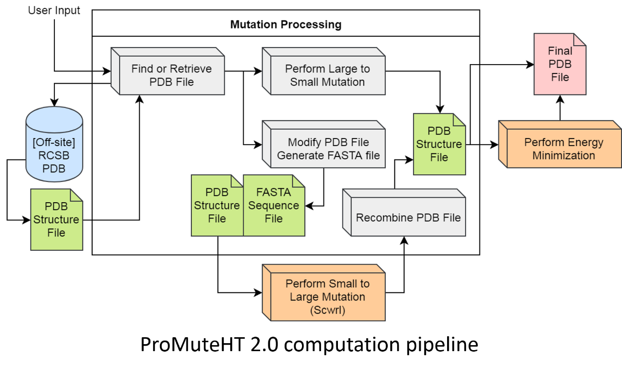
Contributions
Rewritten in C++
Increased efficiency
Change in what Scwrl processes
Only performs energy minimization after select mutations
Accessible surface area is too low
Mutation is not large-to-small

Slide 10
Results

Slide 11
Run Times vs. Previous Version
Invocation | # Residues | # Mutants | ProMute 1.0 Run Times (s) | ProMute 2.0 Run Times (s) | % Improvement
1hhp A:A 3,7,10:20 G | 99 | 13 | 21.9 | 0.6 | 97%
1crn A:A 12:30 pol | 46 | 171 | 220 | 106 | 52%
1pef A:A X:X X | 18 | 342 | 407 | 45 | 89%
1hvr A:B 20:30 X | 198 | 418 | 586 | 954 | 63% worse

Slide 12
Run Times vs. FoldX
Protein | # Mutations | Result | FoldX | ProMute 1.0 | ProMute 2.0 | % Improvement vs. FoldX | % Improvement vs. 1.0
1HHP | 6 | 19 to G, 20 -25 to A | 82.5 | 12.3 | 0.8 | 99% | 93%
1PEF | 18 | All residues to G | 66.5 | 32 | 0.5 | 99% | 98%

Slide 13
Conclusion
Able to increase efficiency in most cases
Reduced File I/O
Selective calculations
Added additional functionality
Provides an industry standard format as output
Can be paired with other programs

Slide 14
Questions?

